Slide 2
Perceptron
Perceptron is a single layer neural network and a multi-layer perceptron is called Neural Networks.
Perceptron is a linear classifier (binary). Also, it is used in supervised learning. It helps to classify the given input data.
Perceptron is usually used to classify the data into two parts, hence known as a Linear Binary Classifier

Slide 4
The perceptron consists of 4 parts.
Input values or One input layer
Weights and Bias
Net sum
Activation Function
The Perceptron is a linear classification algorithm. This means that it learns a decision boundary that separates two classes using a line (called a hyperplane) in the feature space.
As such, it is appropriate for those problems where the classes can be separated well by a line or linear model, referred to as linearly separable.
The coefficients of the model are referred to as input weights and are trained using the stochastic gradient descent optimization algorithm.

Slide 5
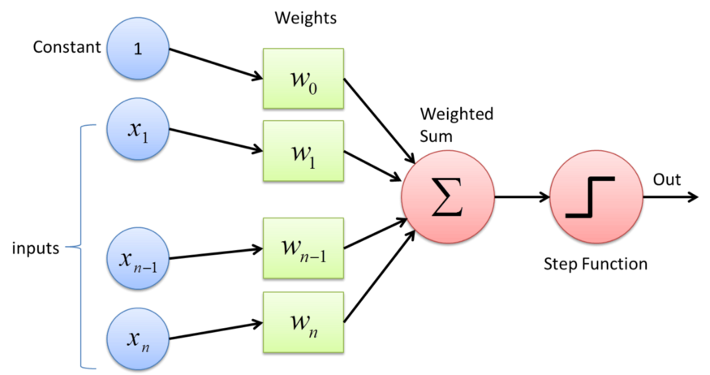
Perceptron

Slide 6
Why do we need Weights and Bias?
Weights shows the strength of the particular node.
A bias value allows you to shift the activation function curve up or down.
Given that the inputs are multiplied by model coefficients, like linear regression and logistic regression, it is good practice to normalize or standardize data prior to using the model.

Slide 7
Why do we need Activation Function?
In short, the activation functions are used to map the input between the required values like (0, 1) or (-1, 1).

Slide 8
It consists of a single node or neuron that takes a row of data as input and predicts a class label. This is achieved by calculating the weighted sum of the inputs and a bias (set to 1). The weighted sum of the input of the model is called the activation.
Activation = Weights * Inputs + Bias
If the activation is above 0.0, the model will output 1.0; otherwise, it will output 0.0.
Predict 1: If Activation > 0.0
Predict 0: If Activation <= 0.0

Slide 9
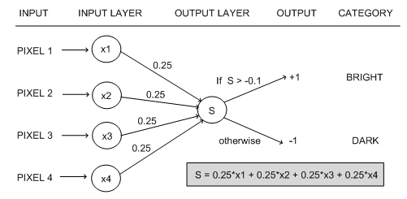

Slide 10
Perceptron update rule
The training dataset are shown to the model one at a time, the model makes a prediction, and error is calculated.
The weights of the model are then updated to reduce the errors for the example. This is called the Perceptron update rule.
This process is repeated for all examples in the training dataset, called an epoch. This process of updating the model using examples is then repeated for many epochs.
Model weights are updated with a small proportion of the error each batch, and the proportion is controlled by a hyperparameter called the learning rate, typically set to a small value.
The learning rate and number of training epochs are hyperparameters of the algorithm that can be set using heuristics or hyperparameter tuning.
This is to ensure learning does not occur too quickly, resulting in a possibly lower skill model, referred to as premature convergence of the optimization (search) procedure for the model weights.
weights(t + 1) = weights(t) + learning_rate * (expected_i – predicted_i) * input_i
Training is stopped when the error made by the model falls to a low level or no longer improves, or a maximum number of epochs is performed.

Slide 11
Activation Functions in Neural Networks
It’s just a thing function that you use to get the output of node. It is also known as Transfer Function.
It is used to determine the output of neural network like yes or no. It maps the resulting values in between 0 to 1 or -1 to 1 etc. (depending upon the function).
The Activation Functions can be basically divided into 2 types-
Linear Activation Function
Non-linear Activation Functions

Slide 12
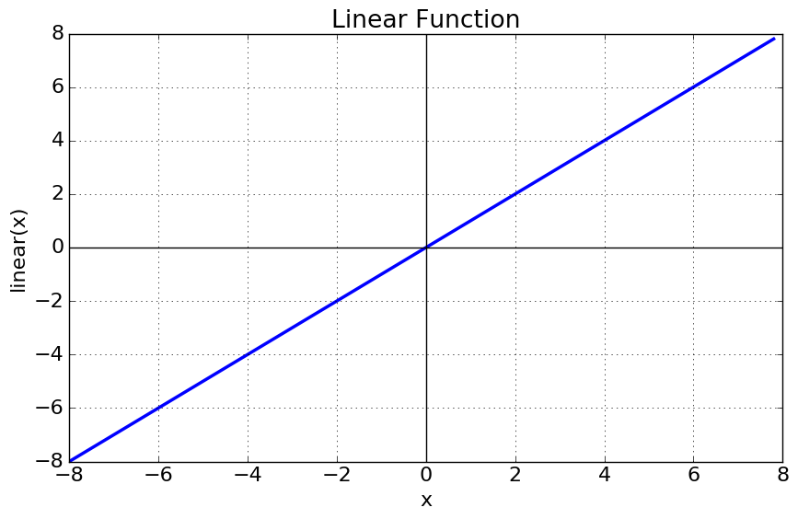
Linear or Identity Activation Function
As you can see the function is a line or linear. Therefore, the output of the functions will not be confined between any range.
Equation : f(x) = x
Range : (-infinity to infinity)
It doesn’t help with the complexity or various parameters of usual data that is fed to the neural networks.

Slide 13
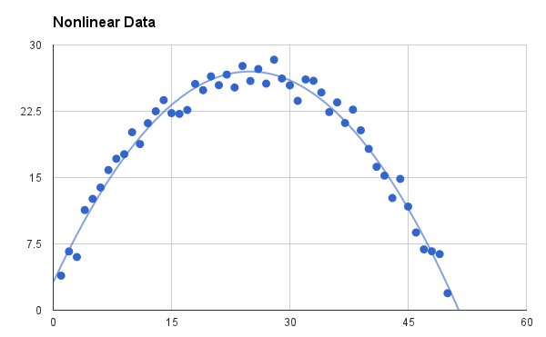
Non-linear Activation Function
The Nonlinear Activation Functions are the most used activation functions. Nonlinearity helps to makes the graph look something like this
It makes it easy for the model to generalize or adapt with variety of data and to differentiate between the output.
The Nonlinear Activation Functions are mainly divided on the basis of their range or curves-

Slide 14
The main terminologies needed to understand for nonlinear functions are:
Derivative or Differential: Change in y-axis w.r.t. change in x-axis.It is also known as slope.
Monotonic function: A function which is either entirely non-increasing or non-decreasing.

Slide 15
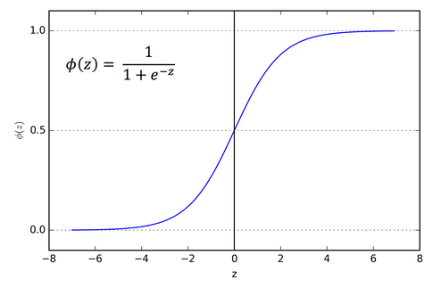
1. Sigmoid or Logistic Activation Function
The Sigmoid Function curve looks like a S-shape.
The main reason why we use sigmoid function is because it exists between (0 to 1). Therefore, it is especially used for models where we have to predict the probability as an output.Since probability of anything exists only between the range of 0 and 1, sigmoid is the right choice.
The function is differentiable.That means, we can find the slope of the sigmoid curve at any two points.
The function is monotonic but function’s derivative is not.
The logistic sigmoid function can cause a neural network to get stuck at the training time.
The softmax function is a more generalized logistic activation function which is used for multiclass classification.

Slide 16
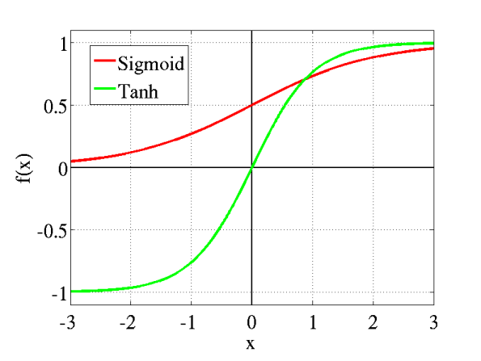
2. Tanh or hyperbolic tangent Activation Function
tanh is also like logistic sigmoid but better. The range of the tanh function is from (-1 to 1). tanh is also sigmoidal (s - shaped).
The advantage is that the negative inputs will be mapped strongly negative and the zero inputs will be mapped near zero in the tanh graph.
The function is differentiable.
The function is monotonic while its derivative is not monotonic.
The tanh function is mainly used classification between two classes.
Both tanh and logistic sigmoid activation functions are used in feed-forward nets.

Slide 17
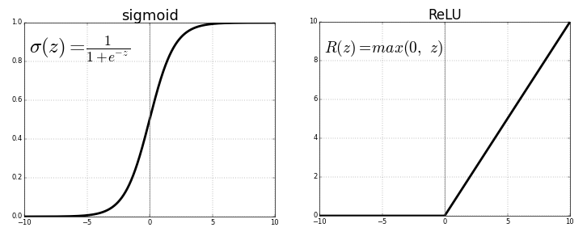
3. ReLU (Rectified Linear Unit) Activation Function
The ReLU is the most used activation function in the world right now.Since, it is used in almost all the convolutional neural networks or deep learning.
As you can see, the ReLU is half rectified (from bottom). f(z) is zero when z is less than zero and f(z) is equal to z when z is above or equal to zero.
Range: [ 0 to infinity)
The function and its derivative both are monotonic.
But the issue is that all the negative values become zero immediately which decreases the ability of the model to fit or train from the data properly. That means any negative input given to the ReLU activation function turns the value into zero immediately in the graph, which in turns affects the resulting graph by not mapping the negative values appropriately.

Slide 18
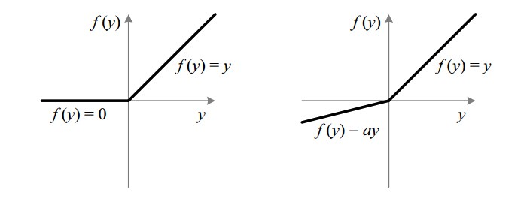
4. Leaky ReLU
The leak helps to increase the range of the ReLU function. Usually, the value of a is 0.01 or so.
When a is not 0.01 then it is called Randomized ReLU.
Therefore the range of the Leaky ReLU is (-infinity to infinity).
Both Leaky and Randomized ReLU functions are monotonic in nature. Also, their derivatives also monotonic in nature.

Slide 19
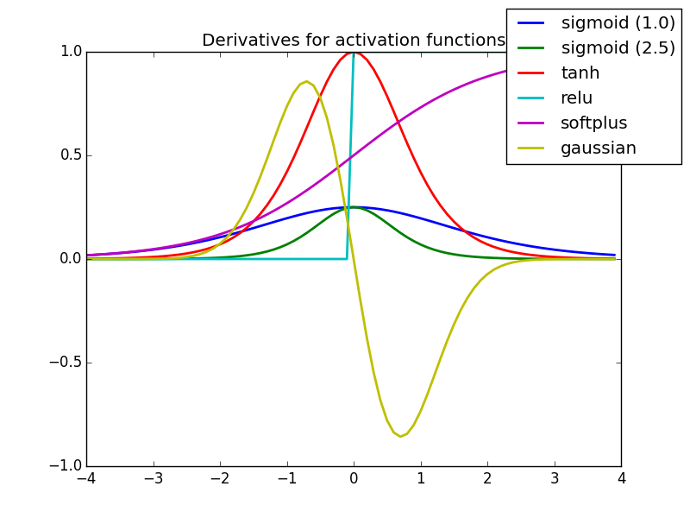
Why derivative/differentiation is used ?
When updating the curve, to know in which direction and how much to change or update the curve depending upon the slope.That is why we use differentiation in almost every part of Machine Learning and Deep Learning.

Slide 20
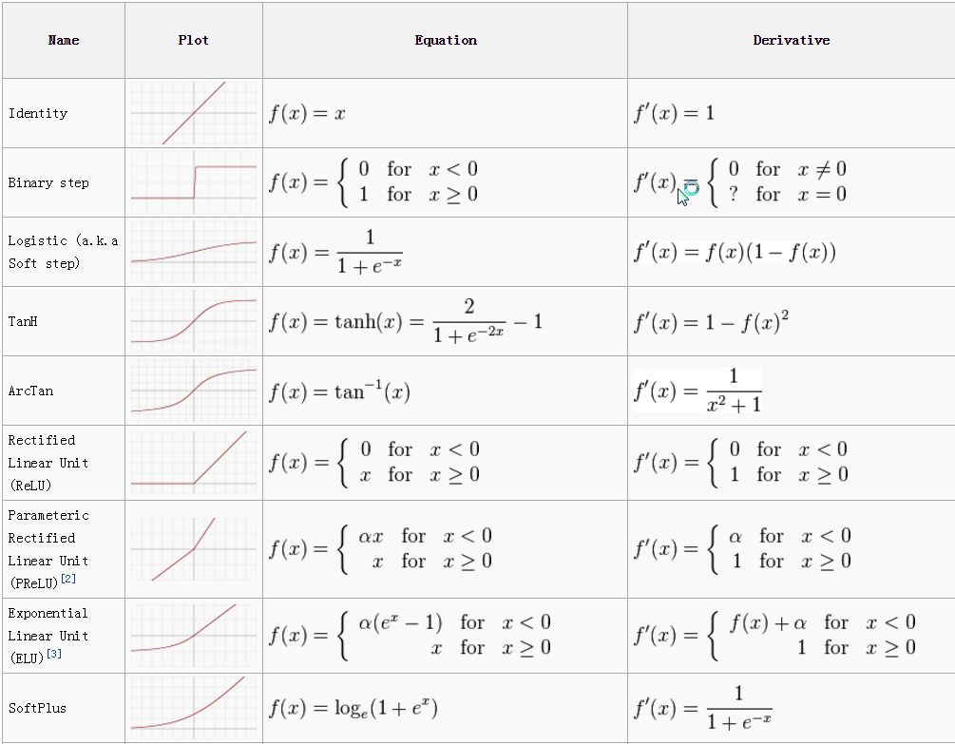

Slide 23
https://towardsdatascience.com/activation-functions-neural-networks-1cbd9f8d91d6

